Slide 1
Nonparametric methods

Slide 2
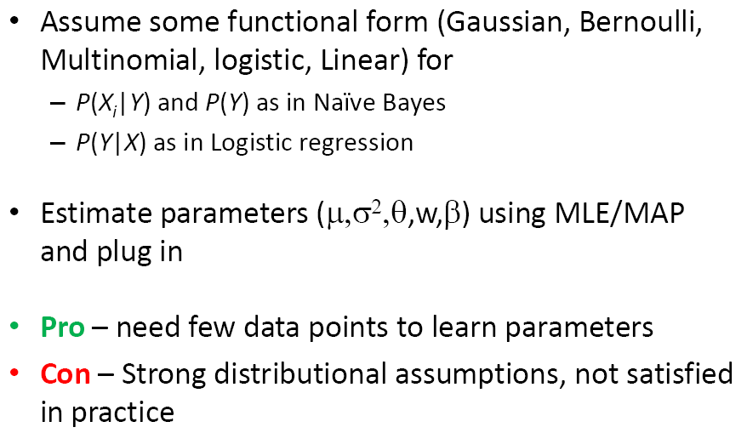
Parametric methods

Slide 3
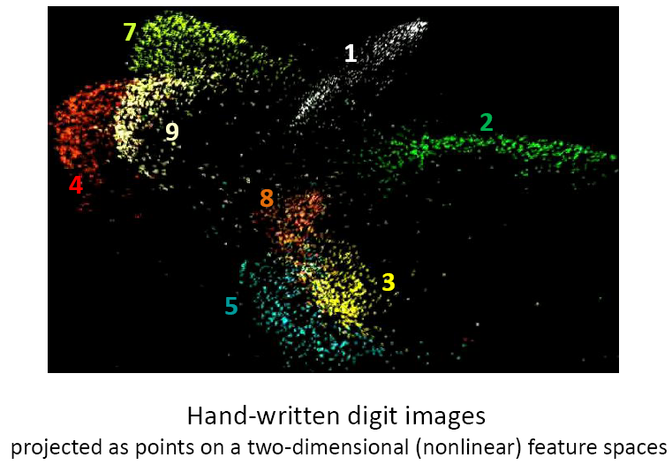
Example

Slide 4
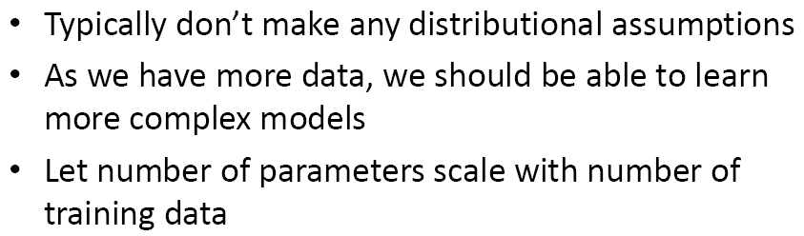
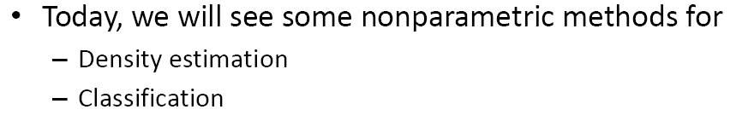
Non-Parametric methods

Slide 5
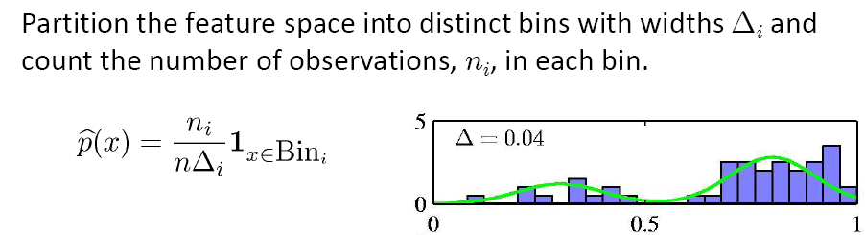
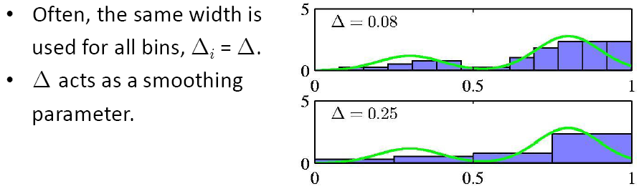
Histogram density estimate

Slide 6
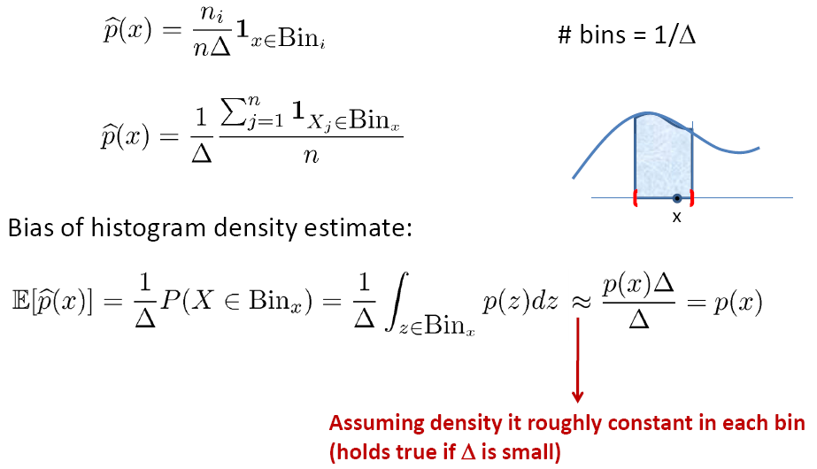
Effect of histogram bin width

Slide 7
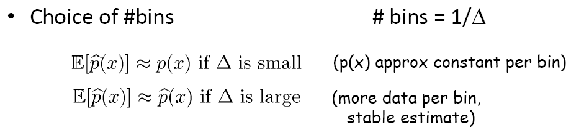


Bias-Variance tradeoff

Slide 8

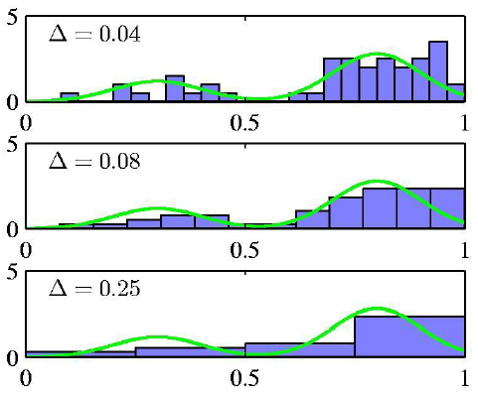
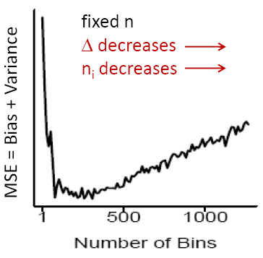
Choice of #bins

Slide 9
Histogram: Conclusion
Pro-once computed, the data set itself can be discarded, advantageous if the data set is large; easily applied if the data points are arriving sequentially; a quick visualization of data in one or two dims
Con-discontinuities on bin edge; (#bins)^{D}
Two hints: local; delta

Slide 10
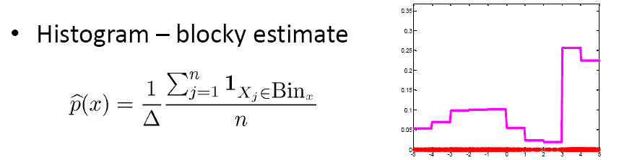
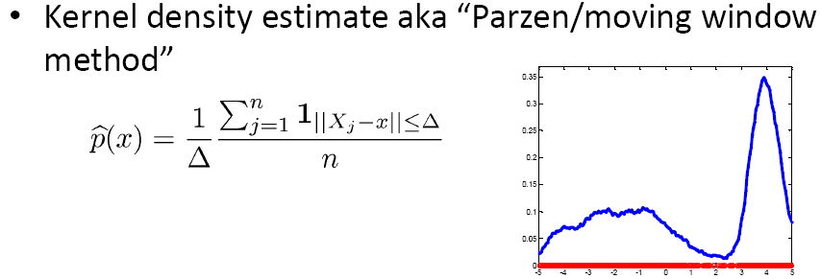
Kernel density estimate

Slide 11
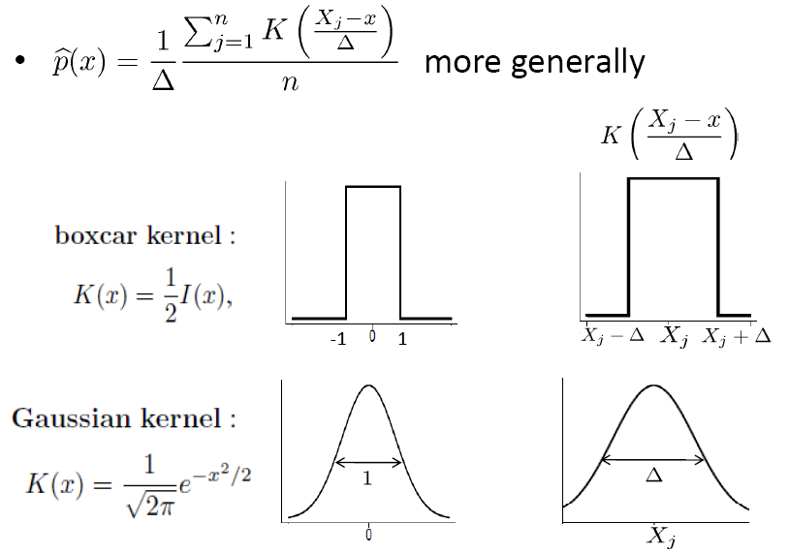
Kernel density estimate

Slide 12
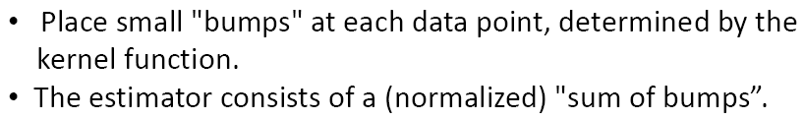
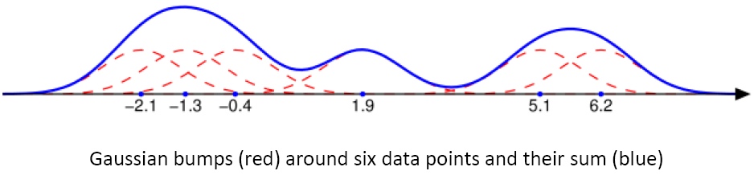
Kernel density estimate

Slide 13
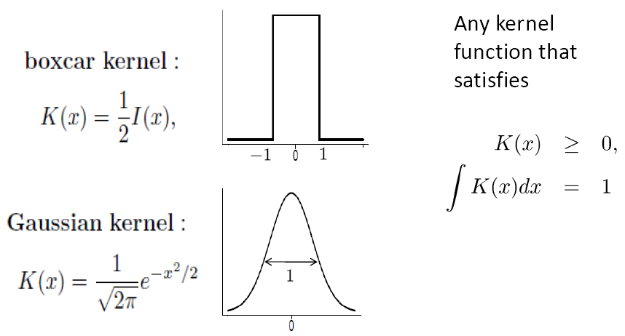
Kernels

Slide 14
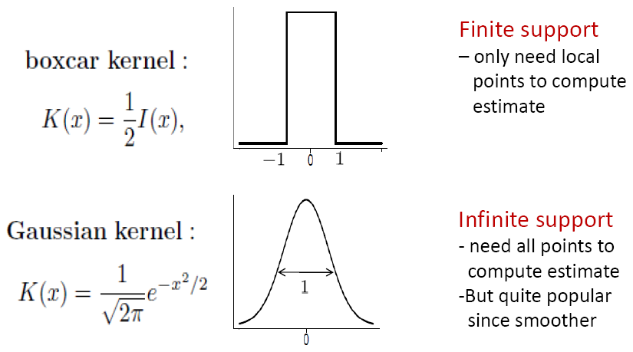
Kernels

Slide 15
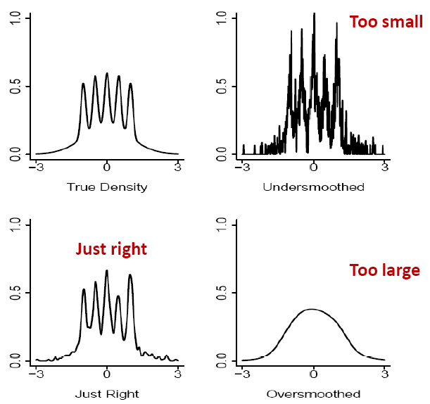
Choice of kernel bandwidth

Slide 16
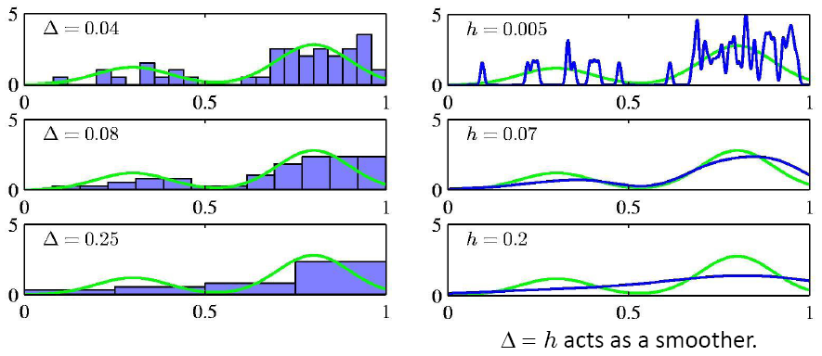
Histograms vs. Kernel density estimation

Slide 17
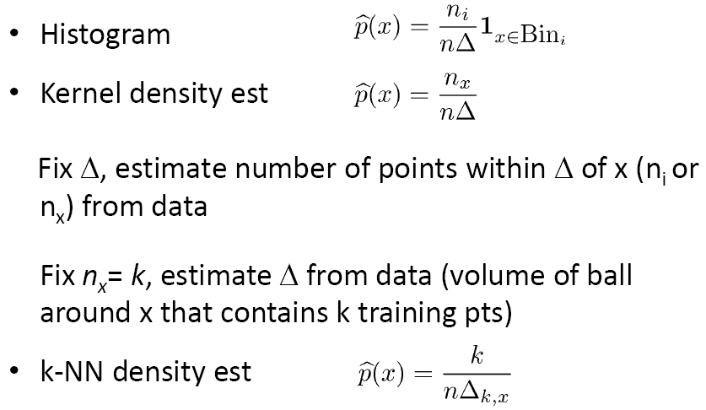
K-NN(Nearest Neighbor) density estimation

Slide 18
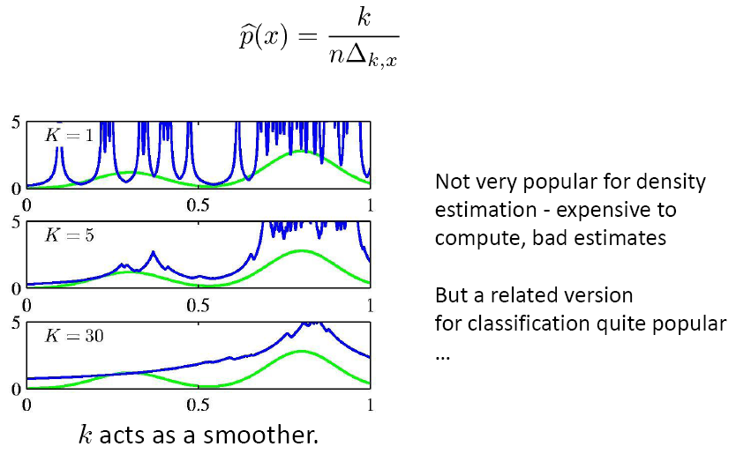
K-NN density estimation

Slide 19
From
Density estimation to
Classification

Slide 20
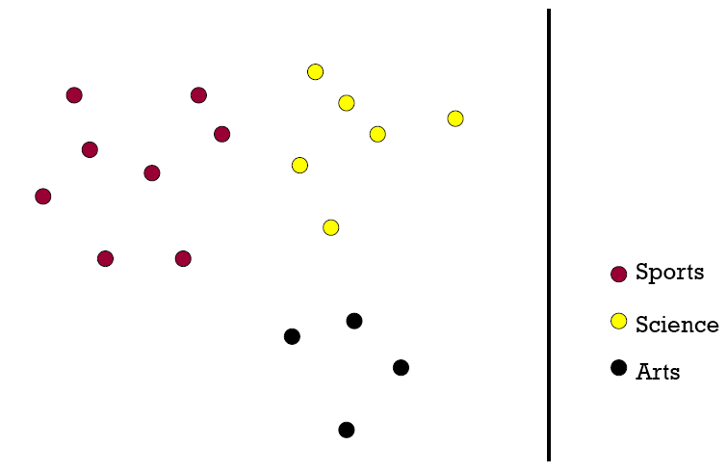
K-NN classifier

Slide 21
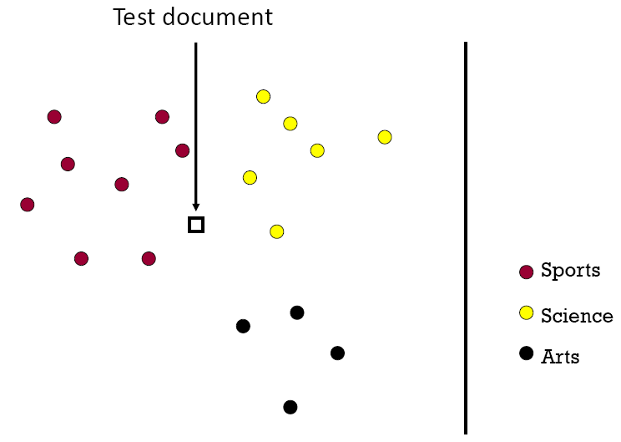
K-NN classifier

Slide 22
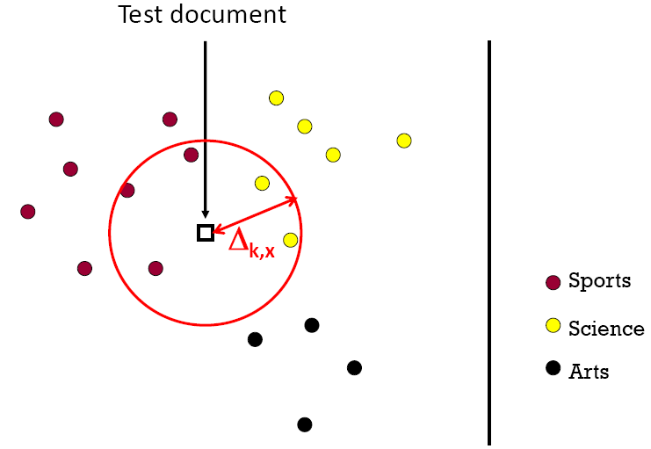
K-NN classifier (K=5)

Slide 23
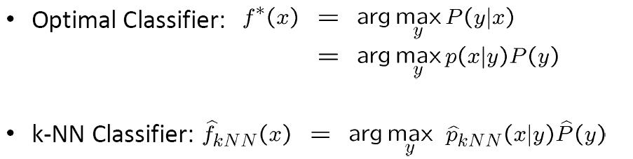

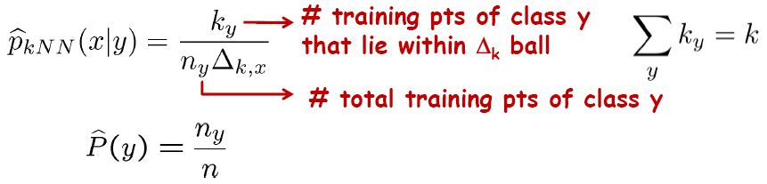
K-NN classifier

Slide 24
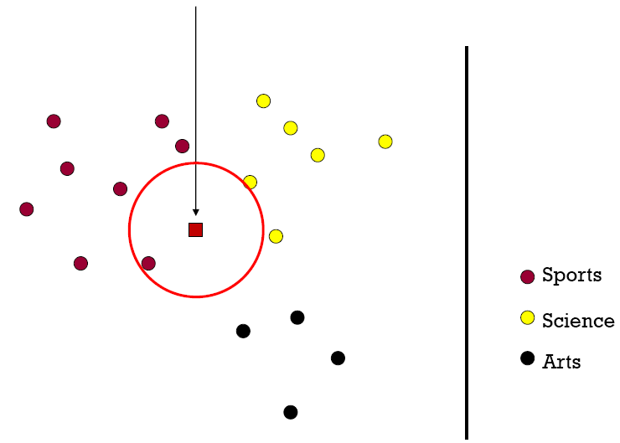
1-Nearest Neighbor (kNN) classifier

Slide 25
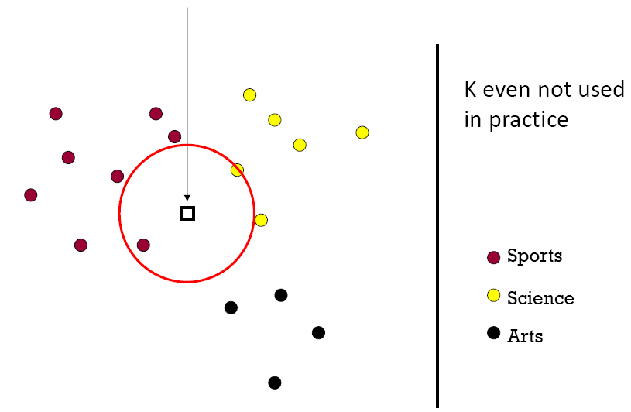
2-Nearest Neighbor (kNN) classifier

Slide 26
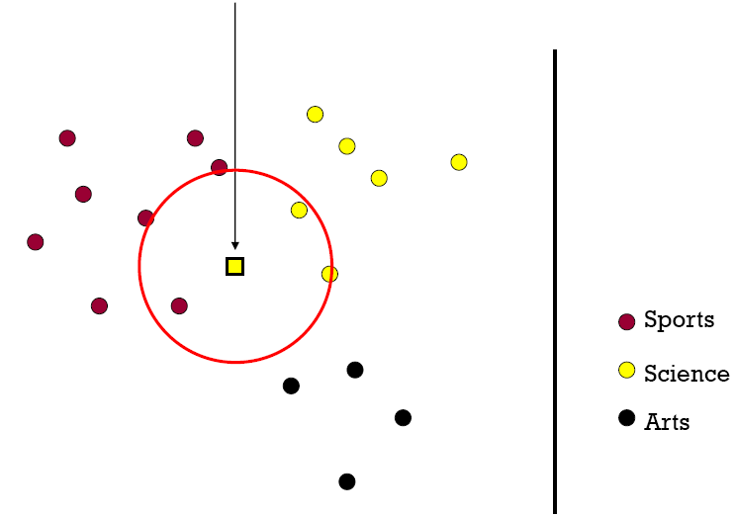
3-Nearest Neighbor (kNN) classifier

Slide 27
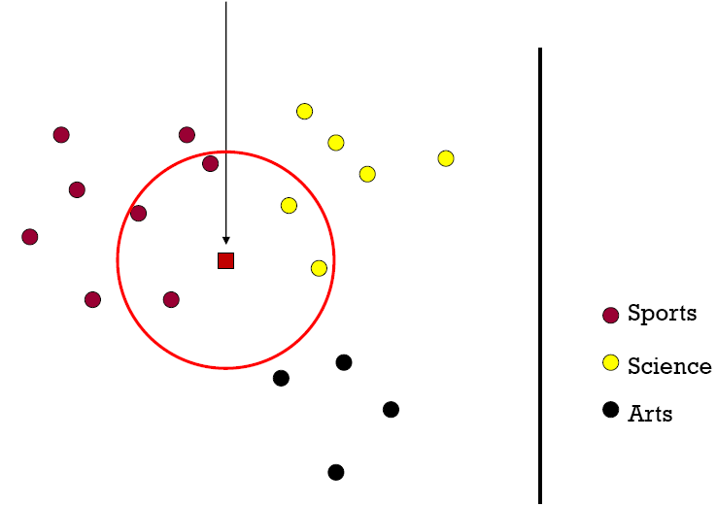
5-Nearest Neighbor (kNN) classifier

Slide 28
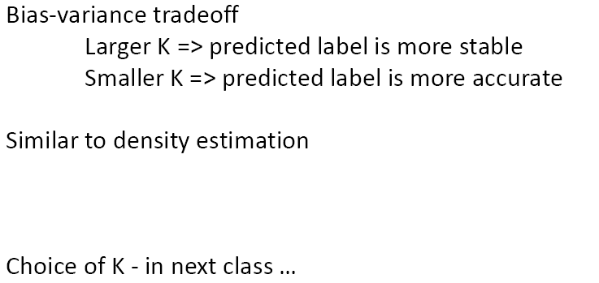
What is the best K?

Slide 29
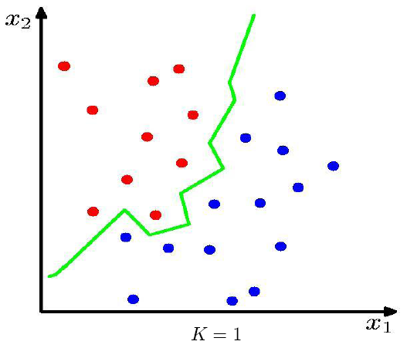
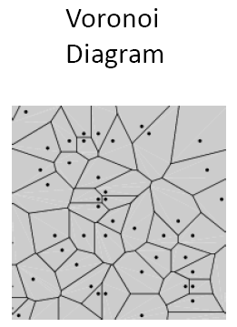
1-NN classifier – decision boundary

Slide 30
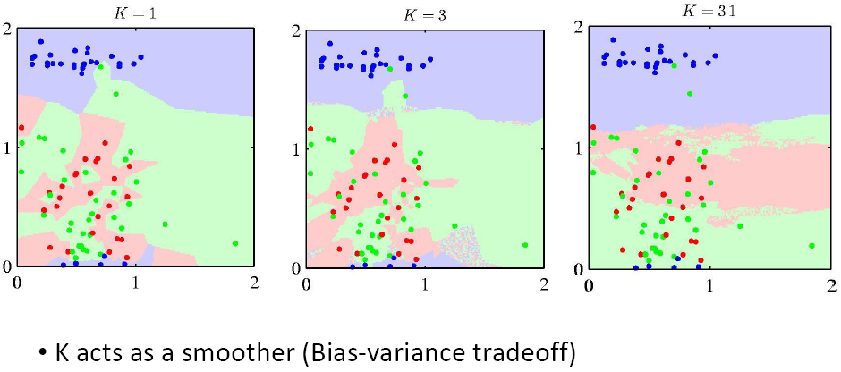
k-NN classifier – decision boundary

Slide 31
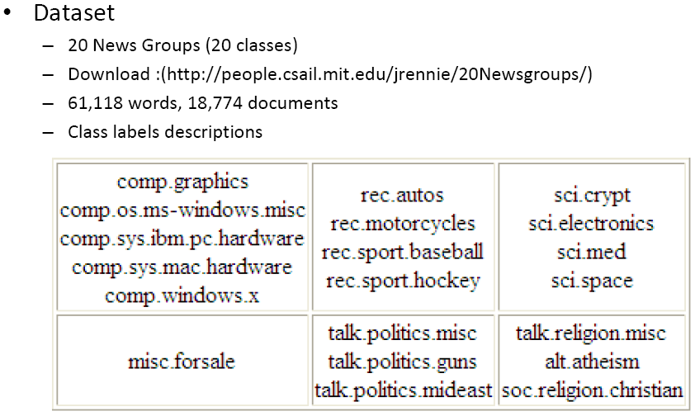
Case Study: kNN for Web Classification

Slide 32
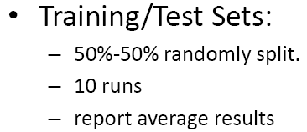
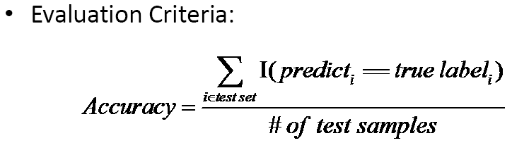
Experimental Setup

Slide 33
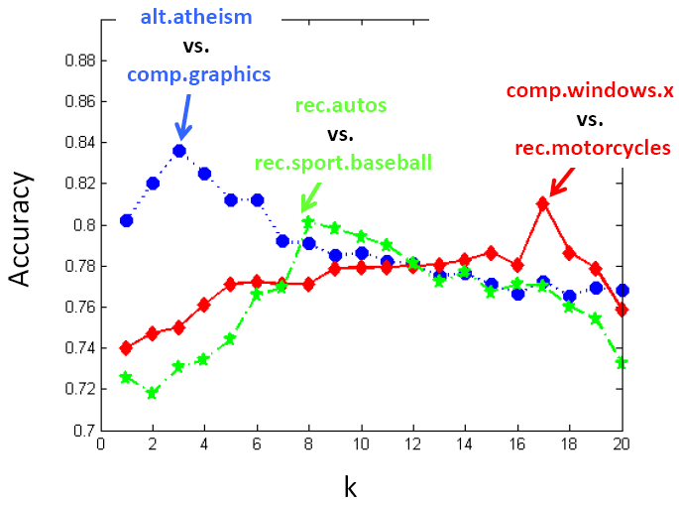
Results: Binary Classes

Slide 34
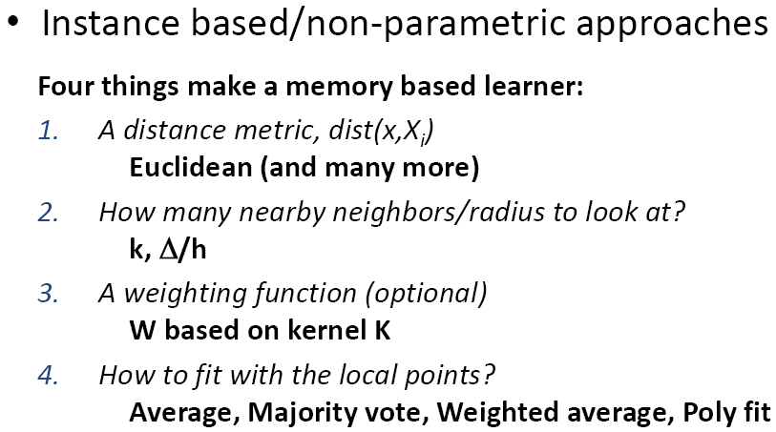
Summary

Slide 35
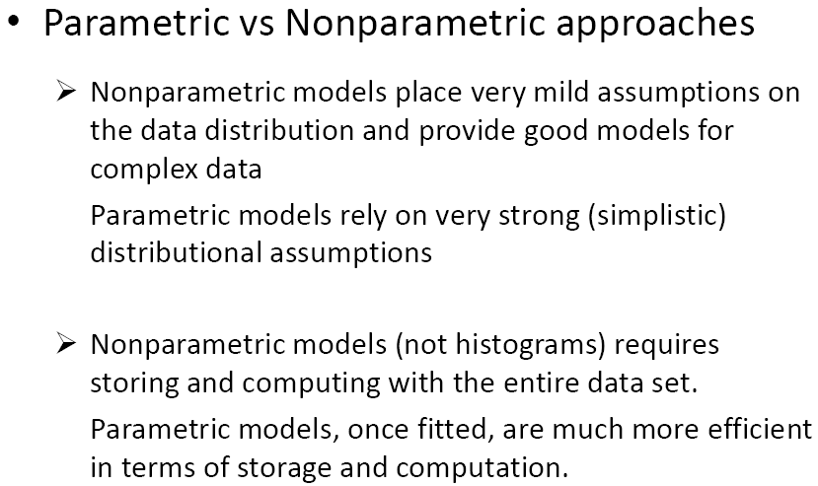
Summary

Slide 36
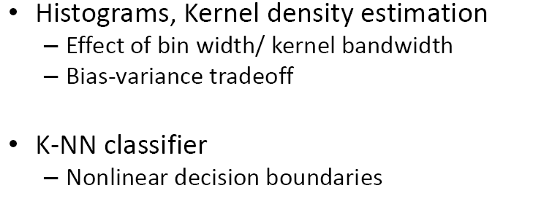
What you should know…

